Slide 1

Spring Framework

Slide 2
IOC in spring
Setter Injection
Constructor Injection
Property Injection
Simple values can be injected using @Value
Injecting Values by Using SpEL

Slide 3
SPEL
Expression Language (EL) is a technology to allow an application to manipulate Java objects at runtime.
Because the Spring Framework is evolving so quickly, there is a need for a standard expression language that can be shared among all the Spring Framework modules as well as other Spring projects.
One powerful feature introduced in Spring 3 is the Spring Expression Language (SpEL). SpEL enables you to evaluate an expression dynamically and then use it in Spring’s ApplicationContext. You can use the result for injection into Spring beans.
Using SpEL, you can access any Spring-managed beans and properties and manipulate them for application use by Spring’s support of sophisticated language features and syntax.

Slide 4
Injecting collections
Often your beans need access to collections of objects rather than just individual beans or values. Therefore,it should come as no surprise that Spring allows you to inject a collection of objects into one of your beans.
Using the collection is simple: you choose either <list>, <map>, <set>, or <props> to represent a List, Map,Set, or Properties instance, and then you pass in the individual items just as you would with any other injection.

Slide 5
Spring Aware
BeanNameAware
ApplicationContextAware

Slide 6
Setting Bean Inheritance
In some cases, you many need multiple definitions of beans that are the same type or implement a shared interface. This can become problematic if you want these beans to share some configuration settings but not others. The process of keeping the shared configuration settings in sync is quite error-prone, and on large projects, doing so can be quite time-consuming.
To get around this, Spring allows you to provide a <bean>definition that inherits its property settings from another bean in the same ApplicationContext instance. You can override the values of any properties on the child bean as required, which allows you to have full control,
but the parent bean can provide each of your beans with a base configuration.

Slide 7
Nesting Applicationcontexts
Spring supports a hierarchical structure for ApplicationContext so that one context is considered the parent of another. By allowing ApplicationContexts to be nested, Spring allows you to split your configuration into different files.
When nesting ApplicationContext instances, Spring allows beans in what is considered the child context
to reference beans in the parent context.

Slide 8
Resolving dependencies
During normal operation, Spring is able to resolve dependencies by simply looking at your configuration file or annotations in your classes. In this way, Spring can ensure that each bean is configured in the correct order so that each bean has its dependencies correctly configured. If Spring did not perform this and just created the beans and configured them in any order, a bean could be created and configured before its dependencies. This would cause all sorts of problems within your application.
Spring is not aware of any dependencies that exist between beans in your code that are
not specified in the configuration.

Slide 9
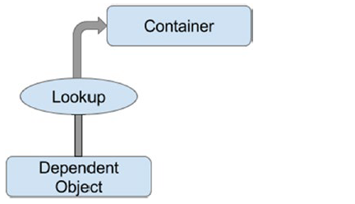
IOC
Contextualized Dependency Lookup
Contextualized dependency lookup (CDL) is similar, in some respects, to dependency pull, but in CDL,lookup is performed against the container that is managing the resource, not from some central registry.

Slide 10
Autowiring your beans
Spring supports 5 modes of autowiring.
byName
byType
constructor
default
no

